Slide 1
CRIME IN BOSTON
Prepared and presented by:
Kevin

Slide 2
TABLE OF CONTENTS
DATA PROFILING
PROBLEM STATEMENT
01
02
INSIGHT EXTRACTION
RECOMMENDATION
03
04
Describe data details and project limitations
Explain business problems to be tackled
Presentation of insights related to the problems
Provide feasible points of improvement

Slide 3


OUR POSITION
Kevin (Presenter)
– Criminology Consultant
Audience
- The Boston Police Department
Audience’s Client (System Implementer)
- Police Dispatch Manager or authorized staff under Boston Police Department responsible for field officer management

Slide 4

DATA PROFILING
Preliminary analysis of the data

Slide 5

HOW FAR SHOULD WE GO ?
Source: https://www.kaggle.com/datasets/AnalyzeBoston/crimes-in-boston by Analyze Boston | Location Boston, Massachusetts, United States of America
Time Span 14 June 2015 – 3 September 2018 | System New Crime Incident Report System (focused on when & where incident occur)

Slide 6
WHAT DO WE GOT ?
Unutilized Data : Street Name
INCIDENT NUMBER (Primary Key) | Offense Code Code, Name, Group and Descriptions
Crime Location District, Reporting Area, Street Name, Coordinates | Crime Details Time (Date and Time), Shooting (Y/N), UCR category

Slide 7

PROBLEM STATEMENT

Slide 8
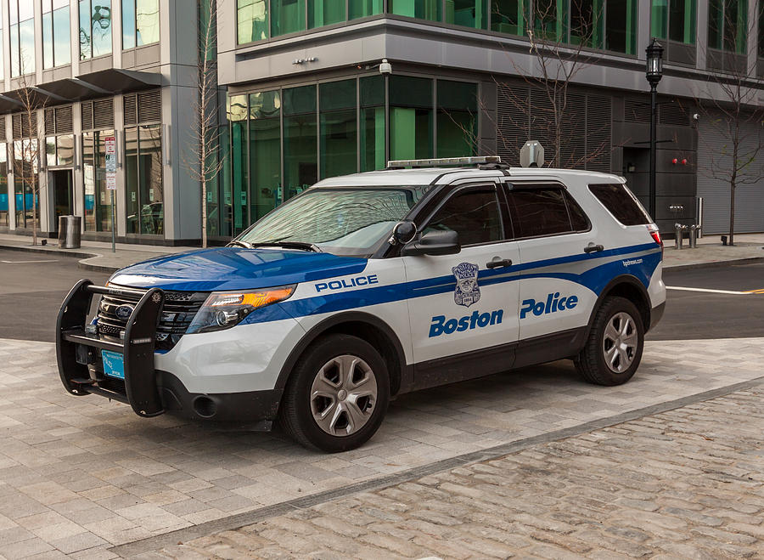
THE BIG PICTURE
FBI: US saw about 25 percent more homicides in 2020 than in 2019 (WashingtonPost)
Homicides in Boston almost doubled from 37 in 2019 to 57 cases in 2020 (Boston.com)
Police officers create guardianship by reminding individuals of the rule of law… So, the physical presence or absence of police in time and space influences individual offenders in their decision to commit crime (“Analysing the Police Patrol Routing Problem: A Review” by Dewinter, M., et al. (2020))

Slide 9
FOLLOW-UP QUESTIONS
Which police’s actions were the most taken for incidents in Boston?
How’s the trend of number of police actions taken by year?
Was there any tendency of police being busier on weekends?
Which police’s actions were the most taken by each of Uniform Crime Reporting (UCR) part?
During what time the police were the busiest?
Which districts need police’s assistance the most and where were the hot-spots for crime action in the city of Boston?

Slide 10

INSIGHT EXTRACTION

Slide 11
1. ACTIONS TAKEN BY POLICE
Offense Code | Offense Code Group | Offense Description | Number of Cases | %
3006 | Medical Assistance | SICK/INJURED/MEDICAL - PERSON | 18,783 | 5.89
3115 | Investigate Person | INVESTIGATE PERSON | 18,747 | 5.88
3831 | Motor Vehicle Accident Response | M/V - LEAVING SCENE - PROPERTY DAMAGE | 16,323 | 5.12
1402 | Vandalism | VANDALISM | 15,153 | 4.75
802 | Simple Assault | ASSAULT & BATTERY | 14,797 | 4.64

Slide 12
1. ACTIONS TAKEN BY POLICE
Insights | Recommendation
Actions taken the most by the police were giving medical assistance to individuals in crime scene | Give field police officers first-aid training based on DRSABC (Danger, Response, Shout, Airway, Breathing, Compression) method Reference: dr. Kevin Adrian Djantin
 | Make good coordination with medical assistance/provider near city’s hot-spots (refer to question no.6) and make sure they have reliable medical facilities
Investigation to individuals were the second most actions taken by police officers (followed by investigation to property in rank 8) | Recruit more experienced sheriffs, professional criminologist or persons needed to perform investigation if necessary.

Slide 13
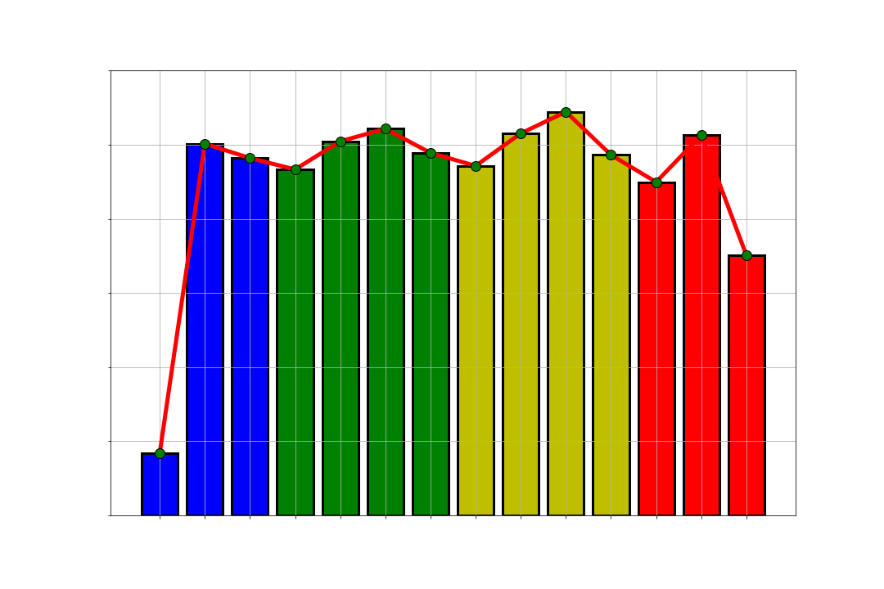
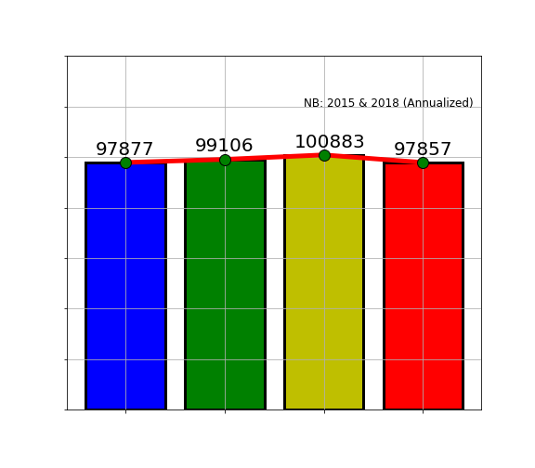
2. TREND

Slide 14
2. TREND
Insights | Recommendation
Number of yearly cases show stable form without any growth or decrease of cases with around 100,000 cases per year. Police’s strategies and programs to tackle crime actions were not effective. | Boston Police Department need to formulate some breakthrough programs to push down crime rate in city of Boston without any support of fire rifles. For past few years, police brutality issues has been the trending topic in the US (The Guardian), so some of actions could be in form of (Vox): 1. Stricter Alcohol Policies 2. Hot-Spot Policing 3. Focused Deterrence Policing 4. Prevent Dropping Out of School Cases 5. Behavioral Intervention Programs 6. Eliminated Blighted Housing
Number of cases per quarter also show stable form, around 25,000 cases per quarter and peaked at 2017Q3.

Slide 15
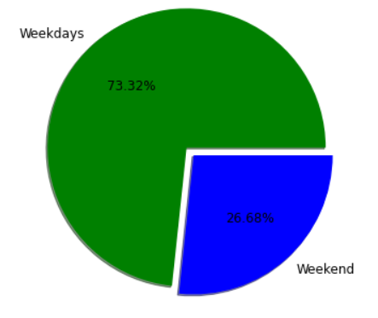
3. BUSY ON WEEKENDS ”Do homicide rates increase during weekends and national holidays?” By Baird, Alison, et al. (2019)
HYPOTHESIS TESTING Null Hypothesis: Proportion of police’s actions on weekends is equal to 50% Alternative Hypothesis: Proportion of police’s actions on weekends is lower than 50% P-value/2: 0.03183261613809501 Result: Null hypothesis is rejected

Slide 16
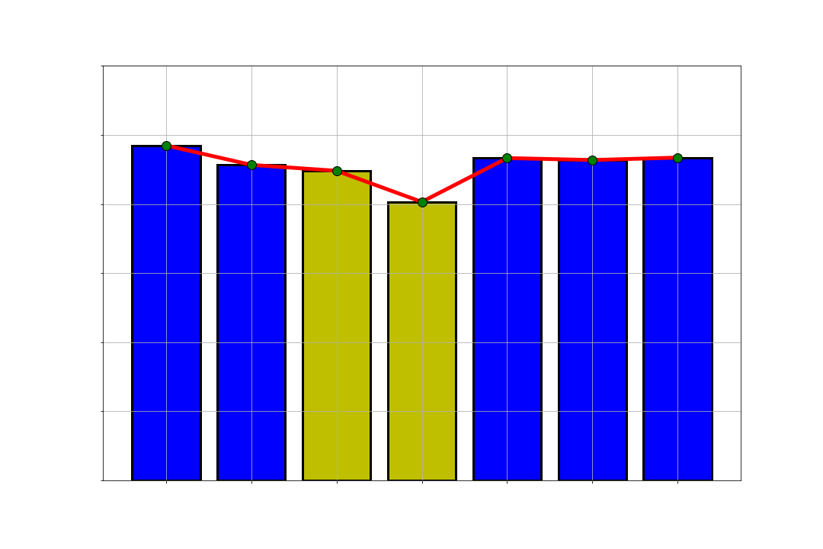
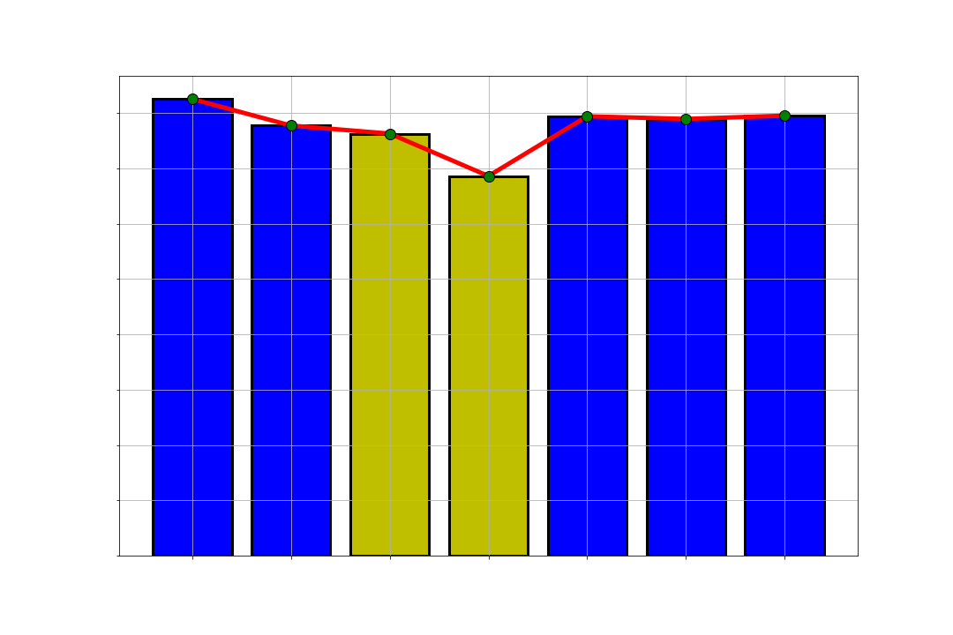
3. BUSY ON WEEKENDS ”Do homicide rates increase during weekends and national holidays?” By Baird, Alison, et al. (2019)

Slide 17
3. BUSY ON WEEKENDS
Insights | Recommendation
Proportion of police’s respond on weekends are significantly lower than weekdays mostly cause by difference in number of days between those two categories: 5 days vs 2 days. | Since the difference between number of police respond each day is not significant, no special attention need to be given to a particular day in a week
When being compared separately as a single day compared to another day, days on weekends (Saturday and Sunday) are lower in number of police respond to any other day in the weekdays category.
Boston is ranked 9th in 10 biggest metropolitan cities in the US in terms of crime rate (source: FBI) | Apply strategies in point number 2 to push down crime number which has been stagnant within years

Slide 18
4. Uniform crime reporting (UCR)
Crime | Cases | %
SICK/INJURED/MEDICAL - PERSON | 18,783 | 11.85
INVESTIGATE PERSON | 18,747 | 11.83
M/V - LEAVING SCENE - PROPERTY DAMAGE | 16,323 | 10.30
VERBAL DISPUTE | 13,099 | 8.26
Crime | Cases | %
VANDALISM | 15,153 | 15.53
ASSAULT & BATTERY | 14,797 | 15.17
THREATS TO DO BODILY HARM | 9,042 | 9.27
FRAUD - FALSE PRETENSE | 4,414 | 4.52
UCR_PART | Number of Cases | %
Part Three | 158,535 | 49.69
Part Two | 97,557 | 30.58
Part One | 61,625 | 19.32
Part Four | 1,232 | 0.39
Crime | Cases | %
LARCENY IN A BUILDING $200 & OVER | 9,073 | 14.72
LARCENY THEFT FROM MV - NON-ACCESSORY | 8,894 | 14.43
LARCENY SHOPLIFTING $200 & OVER | 7,952 | 12.90
LARCENY OTHER $200 & OVER | 5,970 | 9.69

Slide 19
4. Uniform crime reporting (UCR)
Incident Number | Offense Code | Offense Code Group | Description | UCR Part
I080542626-00 | 1848 | Drug Violation | DRUGS - POSS CLASS B - INTENT TO MFR DIST DISP | Part Two
I080542626-00 | 1849 | Drug Violation | DRUGS - POSS CLASS B - COCAINE, ETC. | Part Two
I080542626-00 | 3125 | Warrant Arrest | WARRANT ARREST | Part Three

Slide 20
4. Uniform crime reporting (UCR)
Insights | Recommendation
UCR system can effectively categorize police’s action according to the appropriate UCR Part in the reporting system. However, 1 Incident Number could represent several different actions performed by the police | Formulate new incident numbering format including unique code to separate each actions performed in 1 same incident.

Slide 21
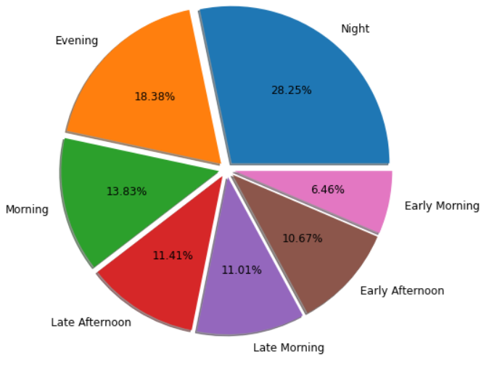
5. Busy hours in weekdays, simple assault happen in daylight while serious crime happen on night (the sleep judge)
Category | From | To
Early Morning | 05.00 | 07.59
Morning | 08.00 | 10.59
Late Morning | 11.00 | 12.59
Early Afternoon | 13.00 | 14.59
Late Afternoon | 15.00 | 16.59
Evening | 17.00 | 19.59
Night | 20.00 | 04.59

Slide 22
5. Busy hours
Insights | Recommendation
Night is the period when police had the most activity during the day, however, night is also the longest time period in a day (9 hours vs 2-3 hours) | 1. Based on study by The Sleep Judge, serious crime tends to happen more on night rather than daylight. Boston Police Department need to have additional field officer standby on night. 2. Police need to adjust the working shift for field officer to accommodate more activities on daylight, by having shift switch on early morning and late afternoon since those are the time when activities were the lowest.
When combined, proportion of actions taken within Evening + Night (total 12 hours) is lower than 50%, therefore police is busier during daytime than night time.

Slide 23
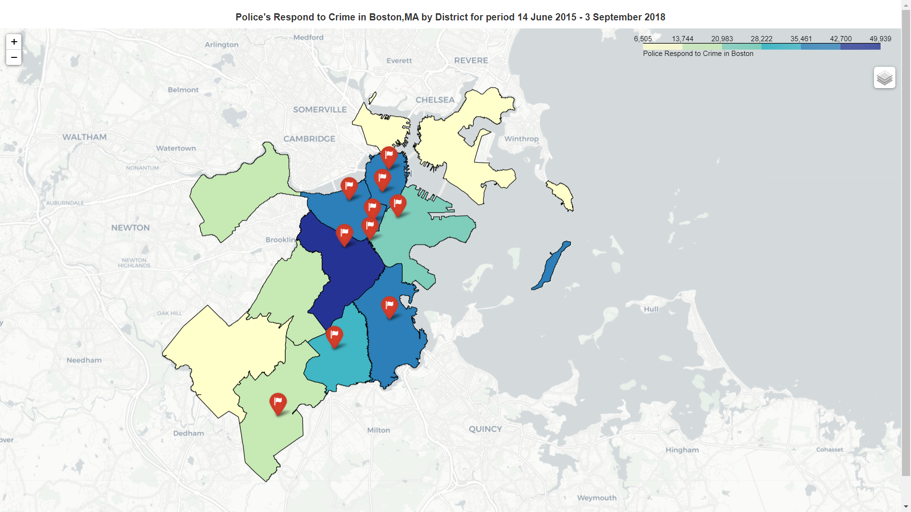
6. Boston’s hot-spots

Slide 24
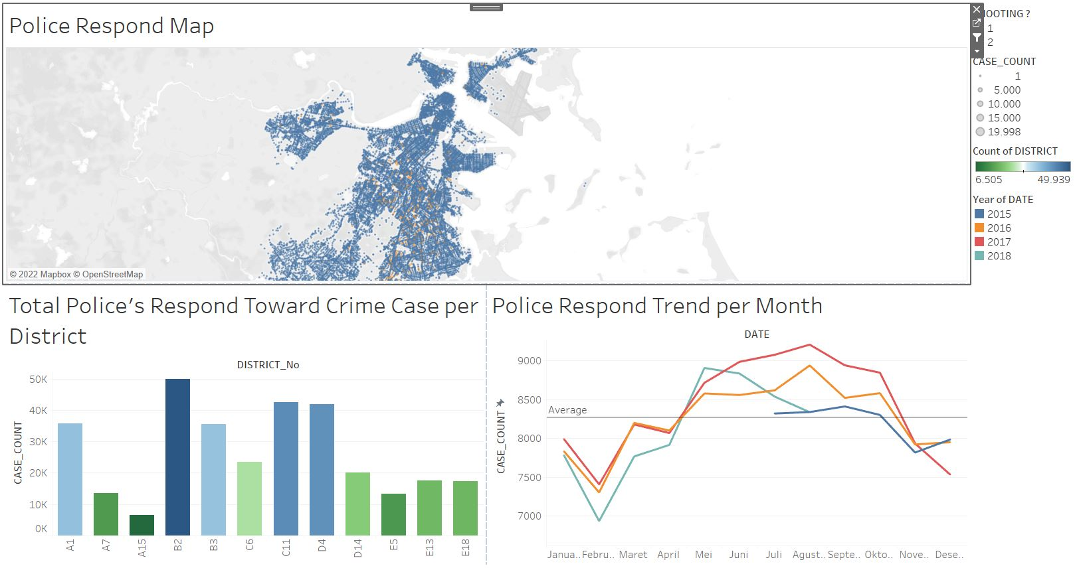
6. Boston’s hot-spots
https://tabsoft.co/3bKDdXw

Slide 25
6. Boston’s hot-spots
Insights | Recommendation
Roxbury is the busiest districts for the police, followed by Downtown, South End and Dorchester. | 1. Boston Police Department need to pay attention to 10 specific hot-spots detected 2. Director need to create a special unit to patrol and control area from north of Downtown to north of Roxbury.
Area from north of Downtown to north of Roxbury contain 7 hot-spots of the city.
District in far south and far north of the city represent low level of activities for police.

Slide 26
CONCLUSION
TRAINING
NO GUNS
01
02
INCIDENT NUMBER
CONTROL HOT-SPOTS
03
04
Deploy first-aid and investigation training program
Don’t use fire rifles to control crime but crime rate still need to be pushed down
Need to formulate new numbering format for UCR System
Focus more on center of the city and specifically around Roxbury

Slide 27
THANKS!
Do you have any questions?
kevinchenkc@yahoo.com
+62 8778 1232862 @kevinchenkc

